Slide 1
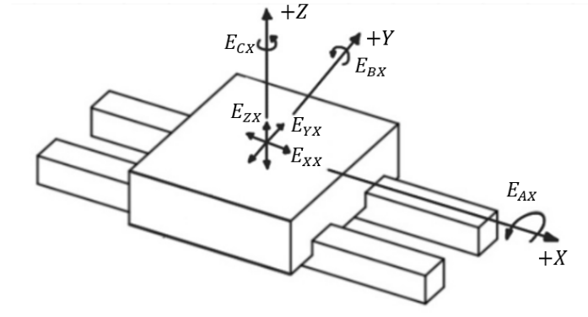
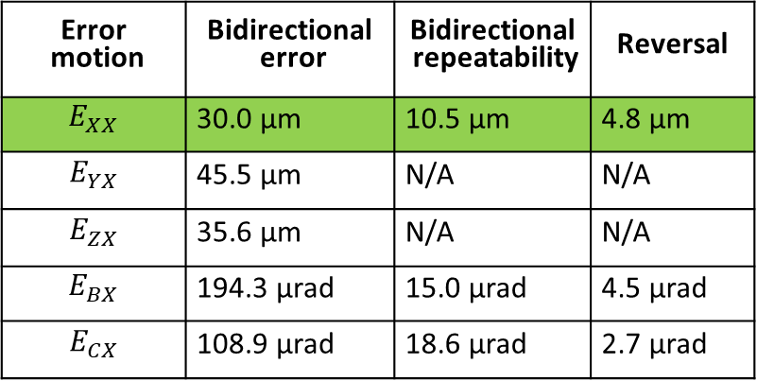
Error motion results
X-axis error motions: ASME B5.54
Error motion | Bidirectional error | Bidirectional repeatability | Reversal
$$E_{XX}$$ | 30.0 μm | 10.5 μm | 4.8 μm
$$E_{YX}$$ | 45.5 μm | N/A | N/A
$$E_{ZX}$$ | 35.6 μm | N/A | N/A
$$E_{BX}$$ | 194.3 μrad | 15.0 μrad | 4.5 μrad
$$E_{CX}$$ | 108.9 μrad | 18.6 μrad | 2.7 μrad

Slide 2
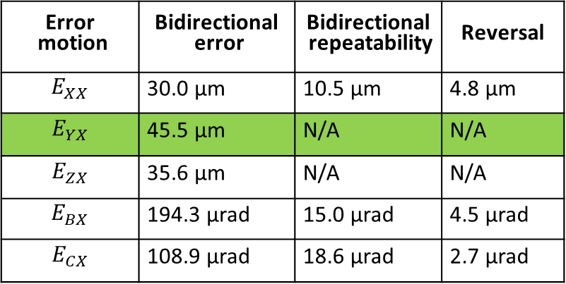
Error motion results
X-axis error motions: ASME B5.54
Error motion | Bidirectional error | Bidirectional repeatability | Reversal
$$E_{XX}$$ | 30.0 μm | 10.5 μm | 4.8 μm
$$E_{YX}$$ | 45.5 μm | N/A | N/A
$$E_{ZX}$$ | 35.6 μm | N/A | N/A
$$E_{BX}$$ | 194.3 μrad | 15.0 μrad | 4.5 μrad
$$E_{CX}$$ | 108.9 μrad | 18.6 μrad | 2.7 μrad

Slide 3
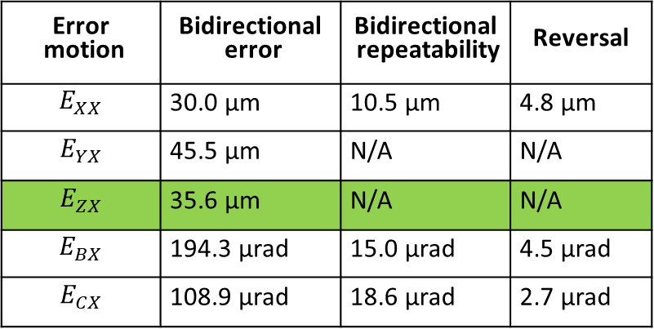
Error motion results
X-axis error motions: ASME B5.54
Error motion | Bidirectional error | Bidirectional repeatability | Reversal
$$E_{XX}$$ | 30.0 μm | 10.5 μm | 4.8 μm
$$E_{YX}$$ | 45.5 μm | N/A | N/A
$$E_{ZX}$$ | 35.6 μm | N/A | N/A
$$E_{BX}$$ | 194.3 μrad | 15.0 μrad | 4.5 μrad
$$E_{CX}$$ | 108.9 μrad | 18.6 μrad | 2.7 μrad

Slide 4
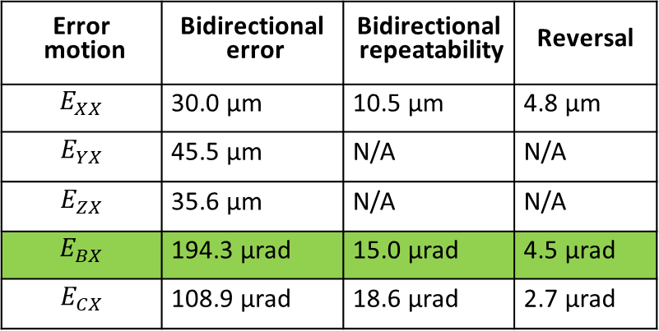
Error motion results
X-axis error motions: ASME B5.54
Error motion | Bidirectional error | Bidirectional repeatability | Reversal
$$E_{XX}$$ | 30.0 μm | 10.5 μm | 4.8 μm
$$E_{YX}$$ | 45.5 μm | N/A | N/A
$$E_{ZX}$$ | 35.6 μm | N/A | N/A
$$E_{BX}$$ | 194.3 μrad | 15.0 μrad | 4.5 μrad
$$E_{CX}$$ | 108.9 μrad | 18.6 μrad | 2.7 μrad

Slide 5
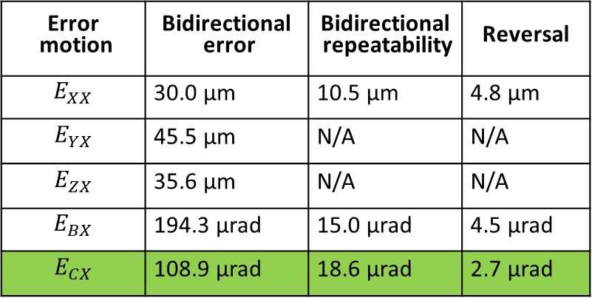
Error motion results
X-axis error motions: ASME B5.54
Error motion | Bidirectional error | Bidirectional repeatability | Reversal
$$E_{XX}$$ | 30.0 μm | 10.5 μm | 4.8 μm
$$E_{YX}$$ | 45.5 μm | N/A | N/A
$$E_{ZX}$$ | 35.6 μm | N/A | N/A
$$E_{BX}$$ | 194.3 μrad | 15.0 μrad | 4.5 μrad
$$E_{CX}$$ | 108.9 μrad | 18.6 μrad | 2.7 μrad

